Slide 1
Analyzing Amazon Sales Data
- Pooja Bahirat

Slide 2
Objective:
Development of a predictive model for predicting sales.
Perform ETL (Extract-Transform-Load) on dataset.
Develop dashboard by using tableau.
Benefits:
Better understand and optimize revenue generation in future
Maximize forecasting accuracy
Make current sales experience our top priority

Slide 3
Introduction
Data Preprocessing:
Importing necessary libraries for data analysis such as:
Pandas, Numpy, Matplotlib & Seaborn etc.
Using pd.read_csv() function stores the data in pandas dataframe named data.
Using data.column showing columns present in dataframe.
info() function show basic information of dataframe like null value count of eachcolumn and their data type Changing the data type of different column for model training and analysis Using describe function on dataframe for getting basic stats of numerical dataset Adding extra column to dataframe which contain only month, year and month with year Using isnull().sum() checking out total null value in all the column of dataframe

Slide 4
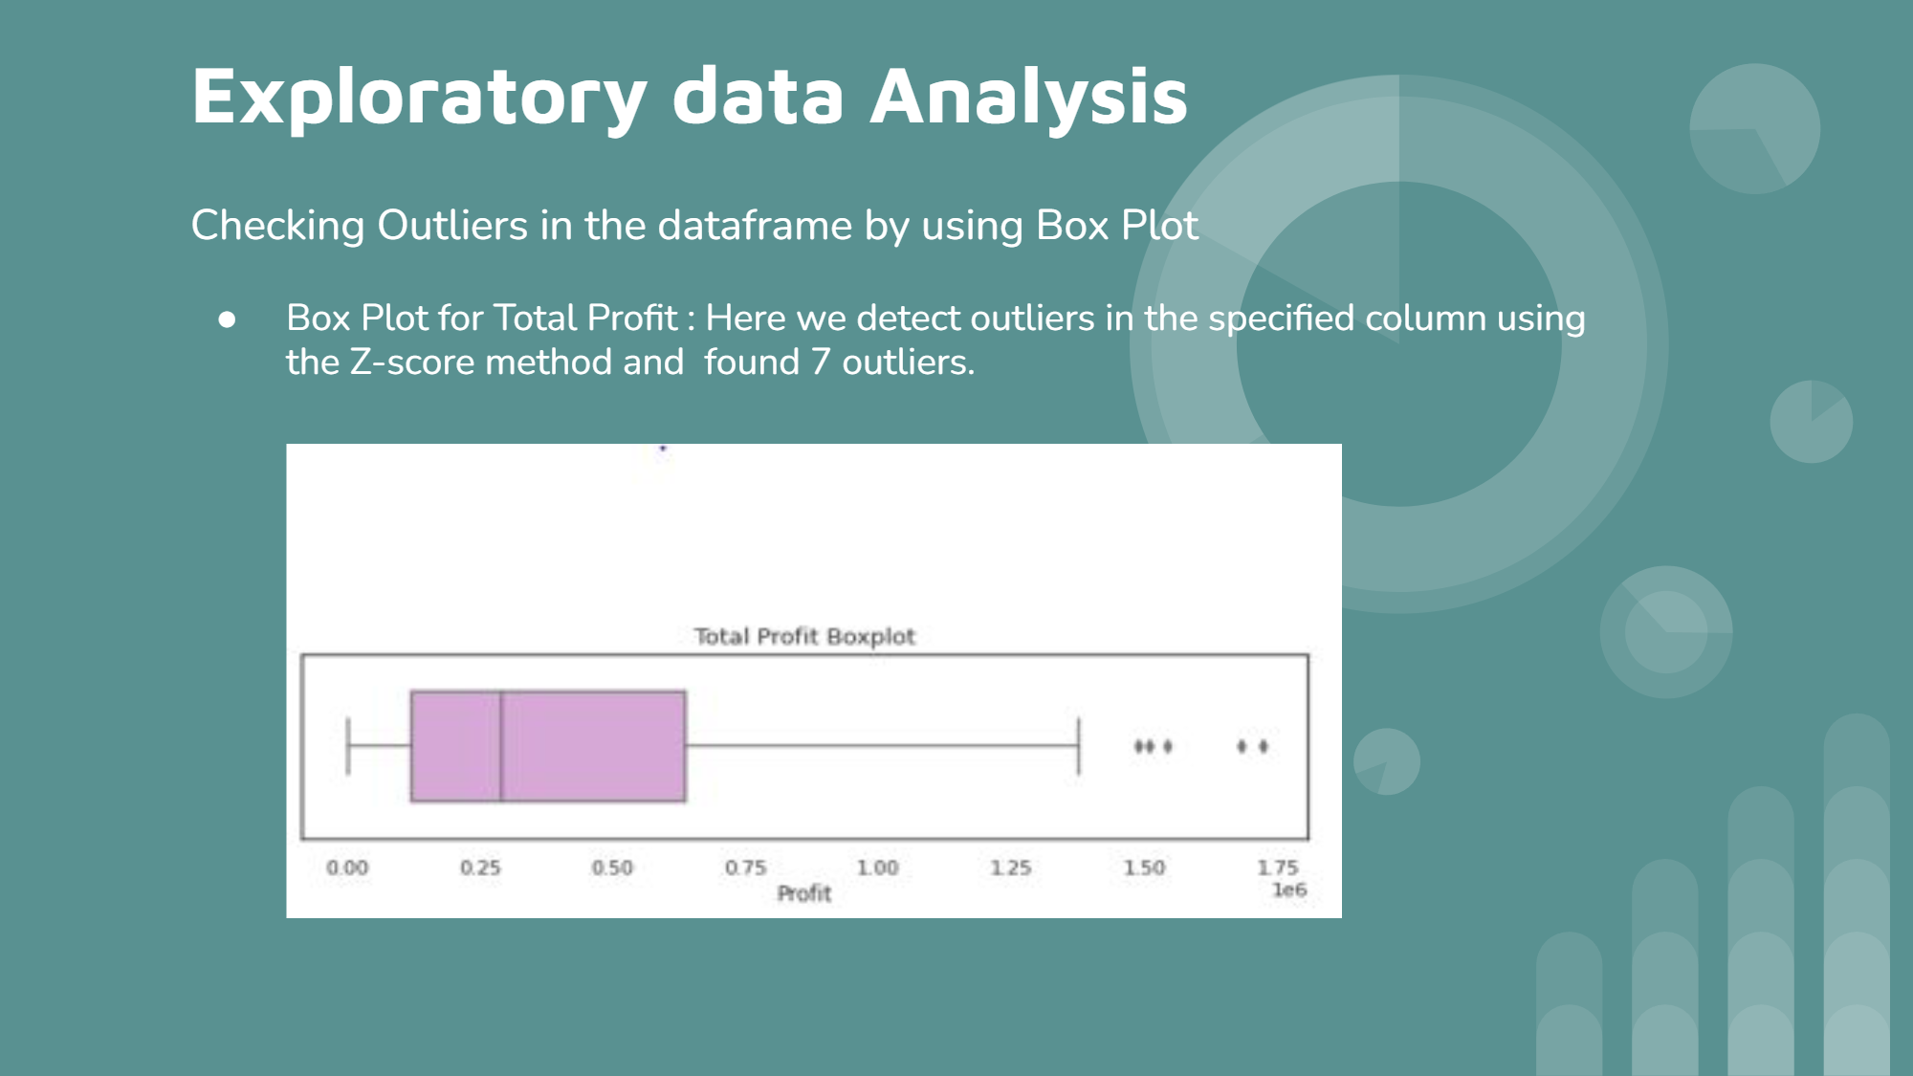
Exploratory data Analysis :
Checking Outliers in the dataframe by using Box Plot.
Box Plot for Total Profit:
Here we detect outliers in the specified column using the Z-score method and found 7 outliers.

Slide 5
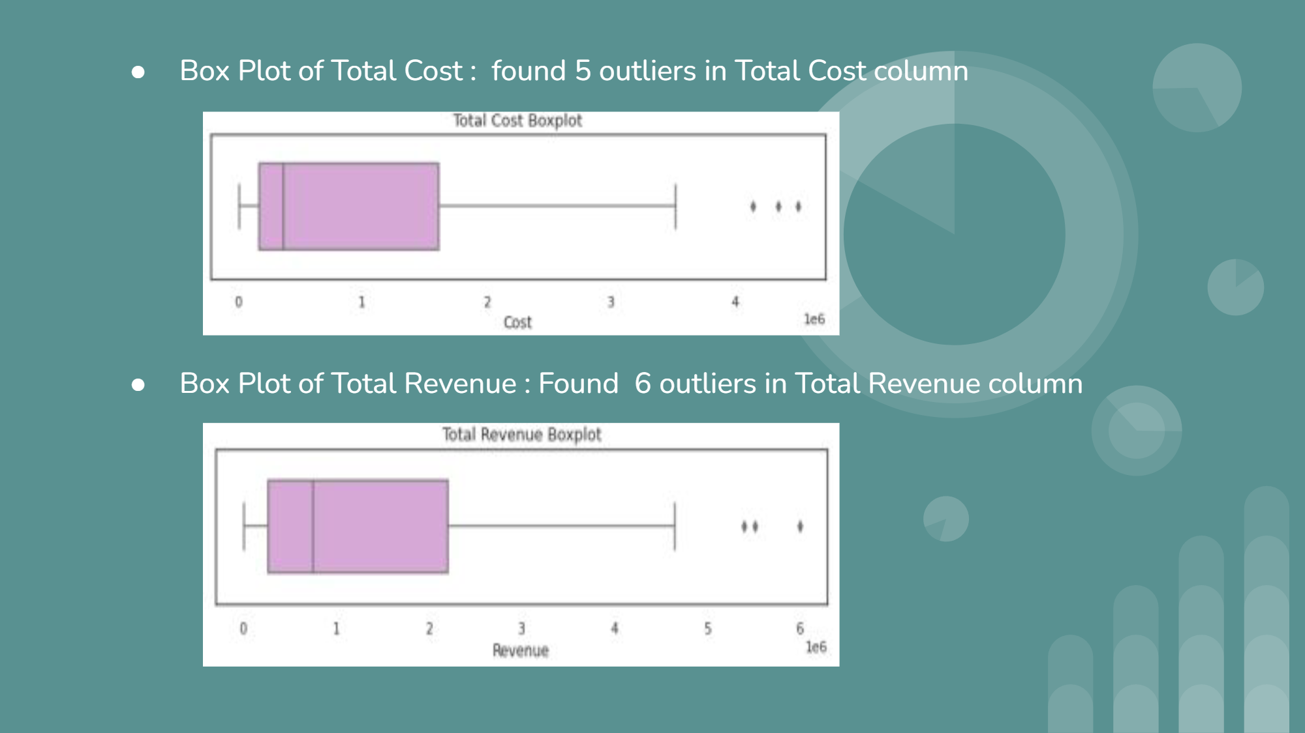
Box Plot of Total Cost: found 5 outliers in Total Cost column
Plot of Total Revenue: Found 6 outliers in Total Revenue column

Slide 6
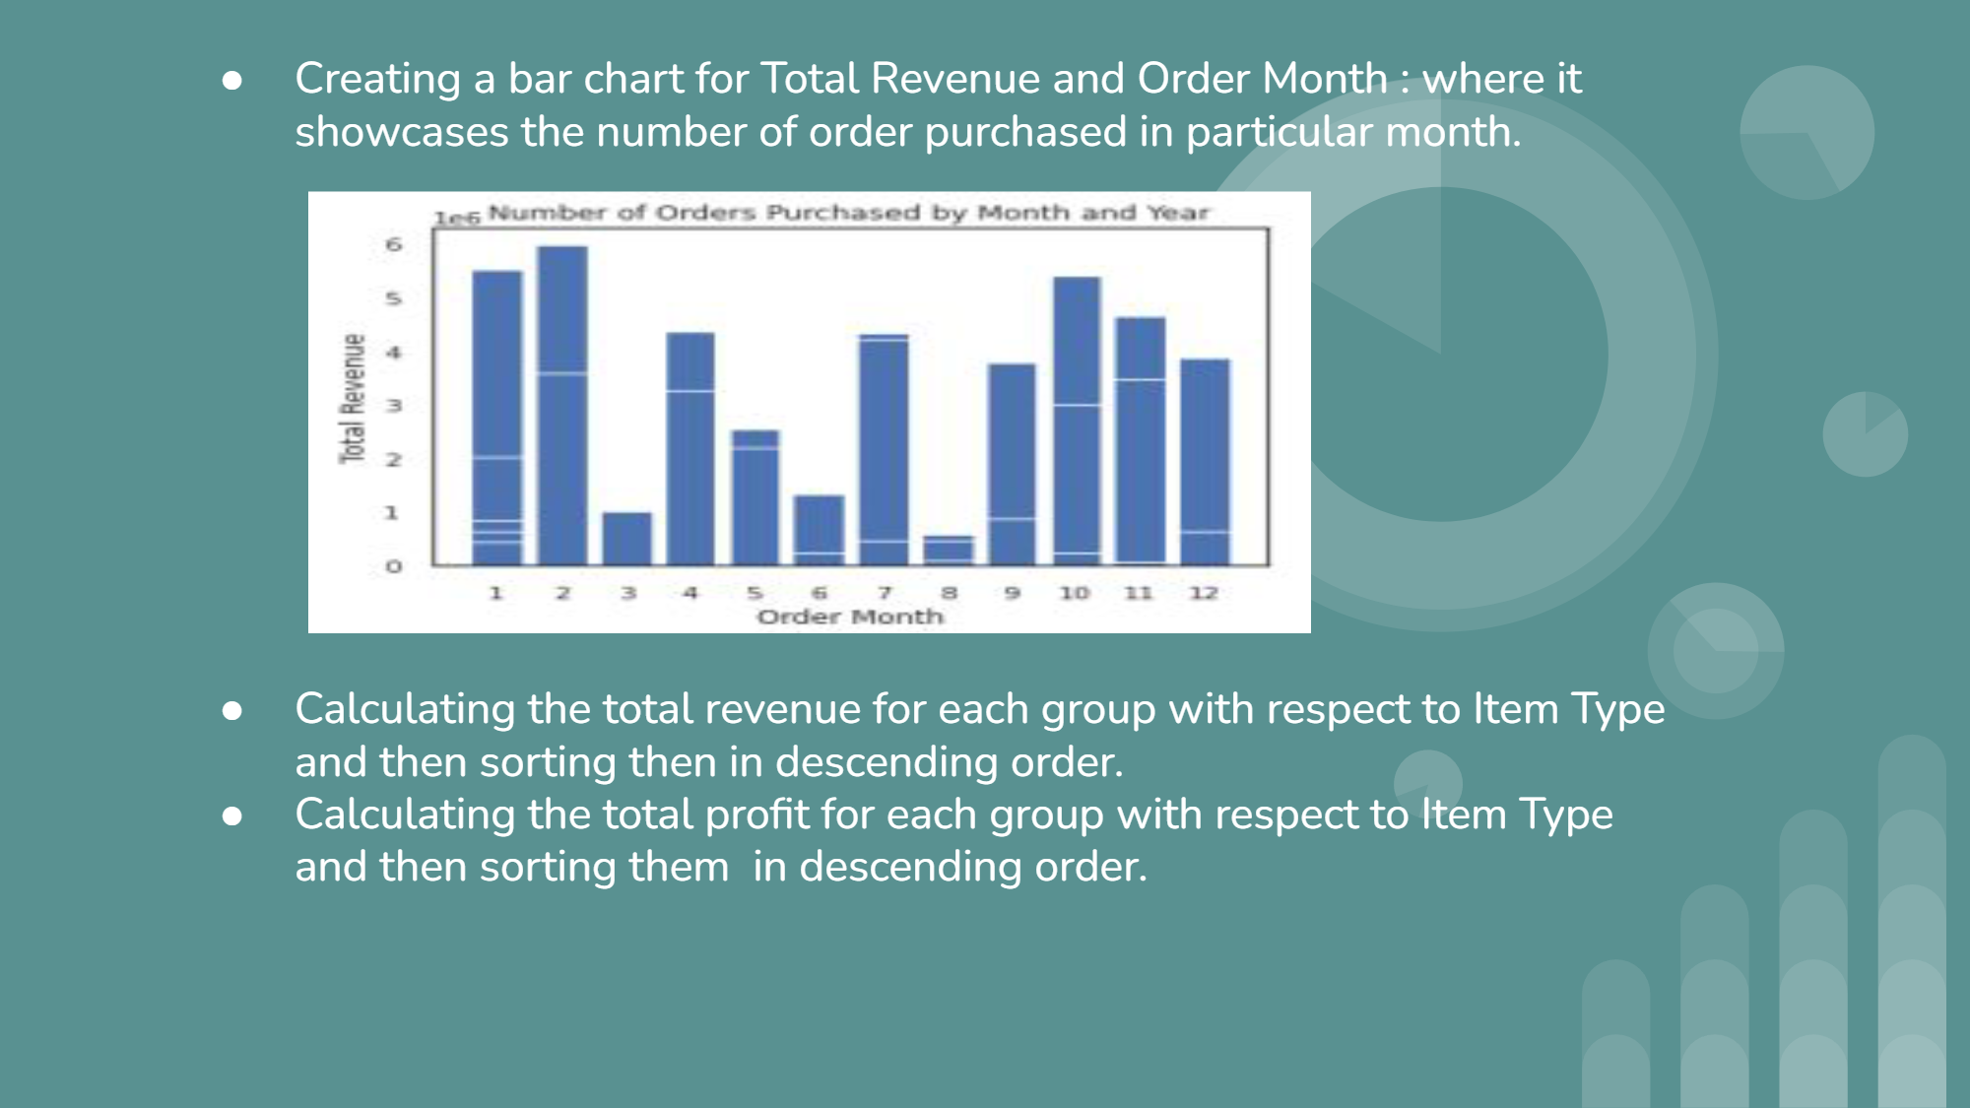
Creating a bar chart for Total Revenue and Order Month: where it showcases the number of order purchased in particular month.
Calculating the total revenue for each group with respect to Item Type and then sorting then in descending order.
Calculating the total profit for each group with respect to Item Type and then sorting them in descending order.

Slide 7
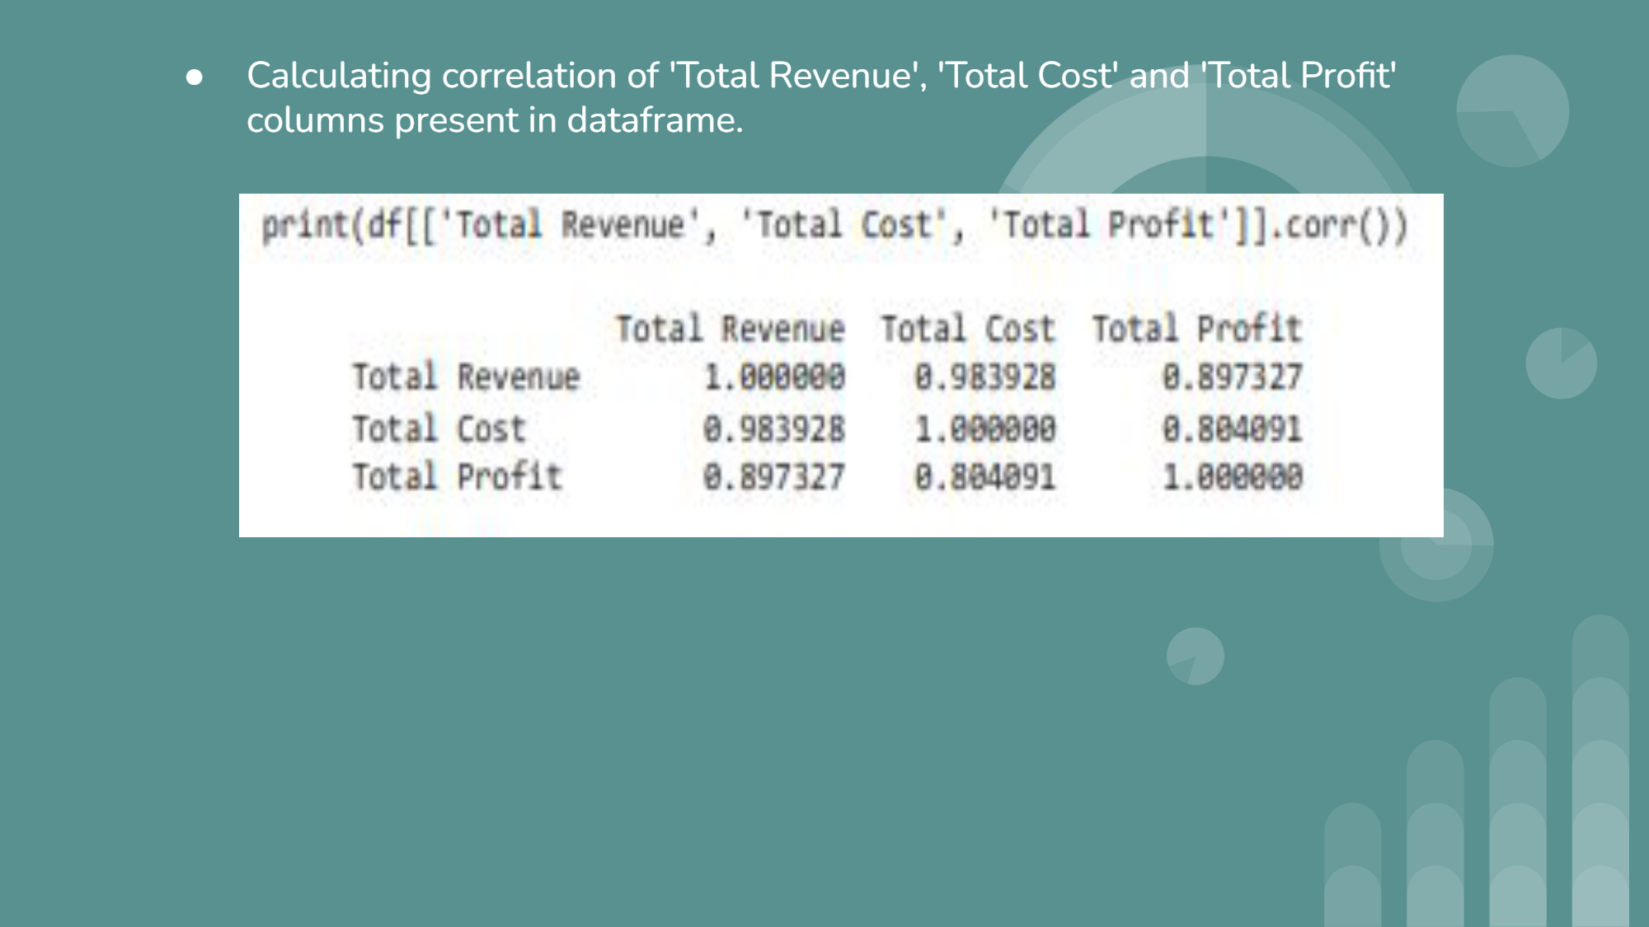
Calculating correlation of 'Total Revenue', 'Total Cost' and 'Total Profit' columns present in DataFrame.

Slide 8
Predictive Analytics :
Label Encoding of Item Type, Sales Channel and Order Priority for model training.
Dropping columns Region, Country, Order Date MonthYear, Order ID and Ship Date.
Pycaret library :
PyCaret is an open-source, low-code machine learning library in Python.
Allows users to quickly and easily build, compare, and deploy machine learning models on structured and tabular data.
Reduce the amount of code needed to build a model.
It provides preprocessing and feature engineering functions.
Automatic model selection and hyperparameter tuning, Support for a wide range of machine learning algorithms.

Slide 9
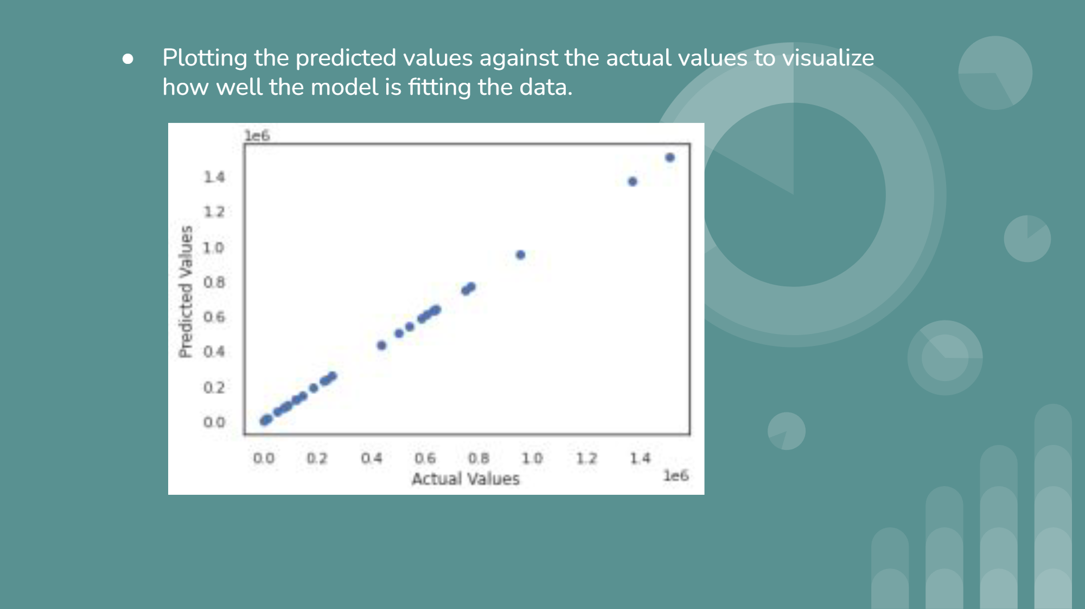
Plotting residuals for Lasso Least Angle Regression based trained model
prediction error plot for Lasso Least Angle Regression based trained model.

Slide 10
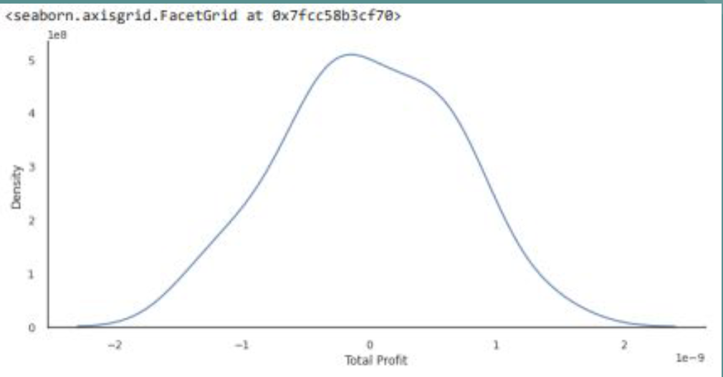
Implementation of Linear RegressionSelecting the independent variables and target variable.
Splitting the data into training and testing datasets.
Standardizing the dataset.
Performing fit transform on X_train dataframe.
Performing fit transform on X_test dataframe.
Applying Linear Regression on X_train and y_train.
Calculating mean squared error.Creating kernel density estimate plot.

Slide 11
plotting the predicted values against the actual values to visualize how well the model is fitting the data.

